Slide 1


Slide 2
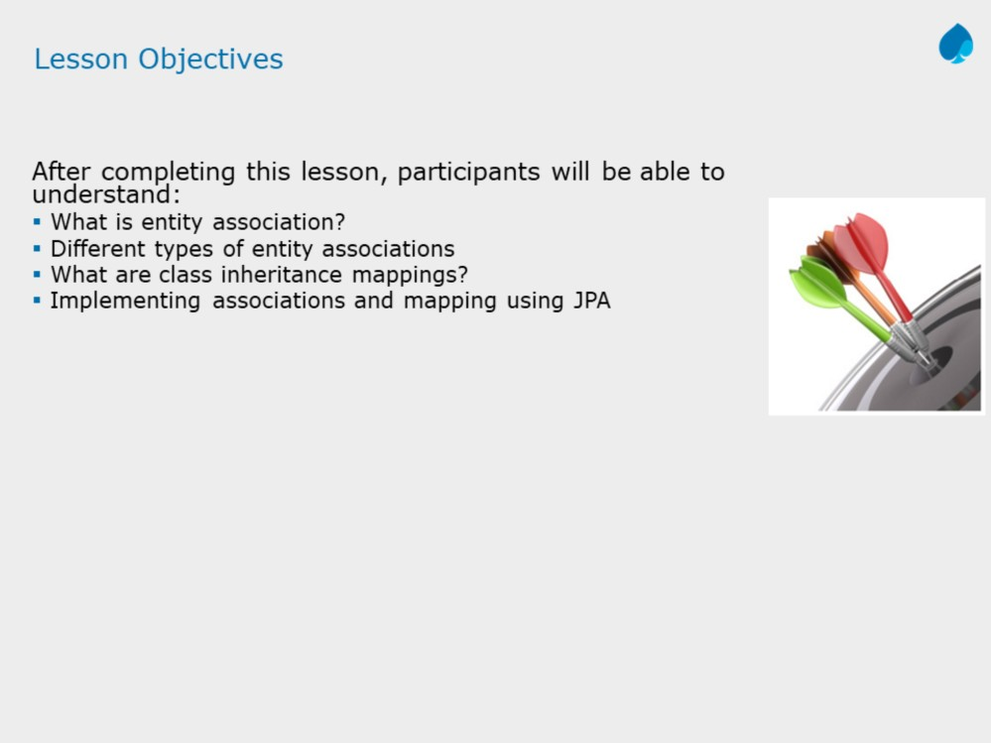

Slide 3
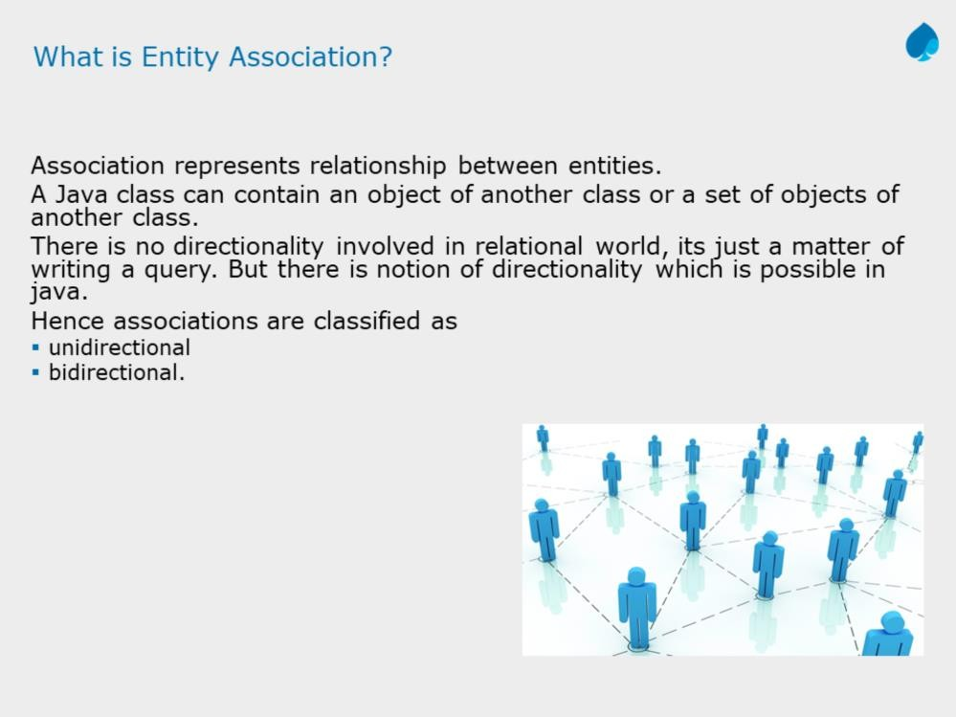

Slide 4
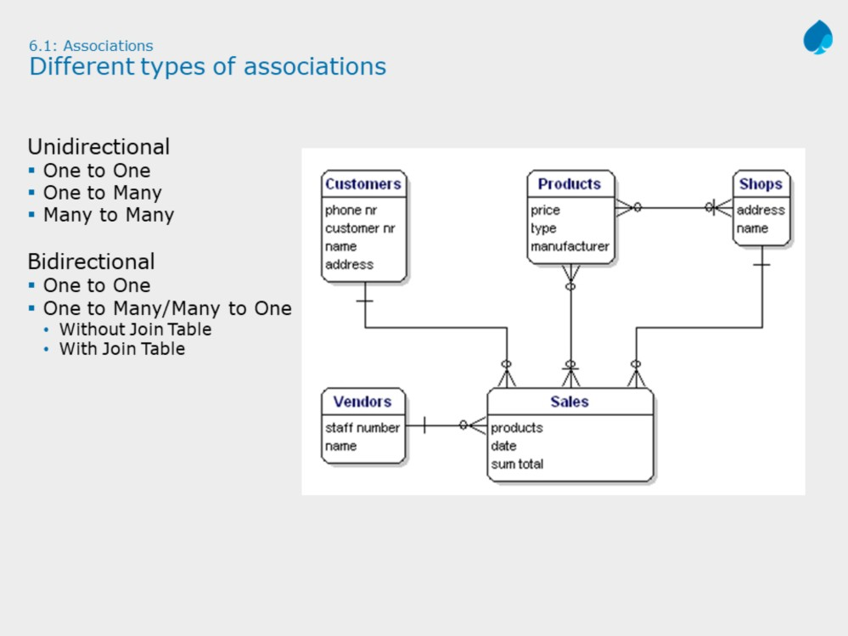

Slide 5
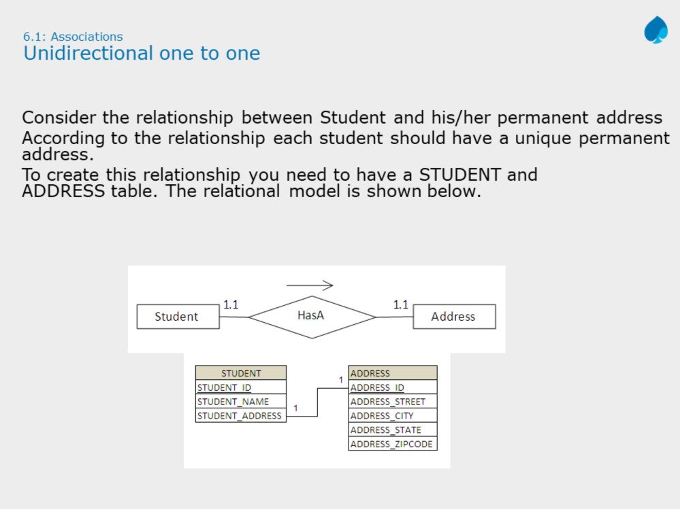

Slide 6
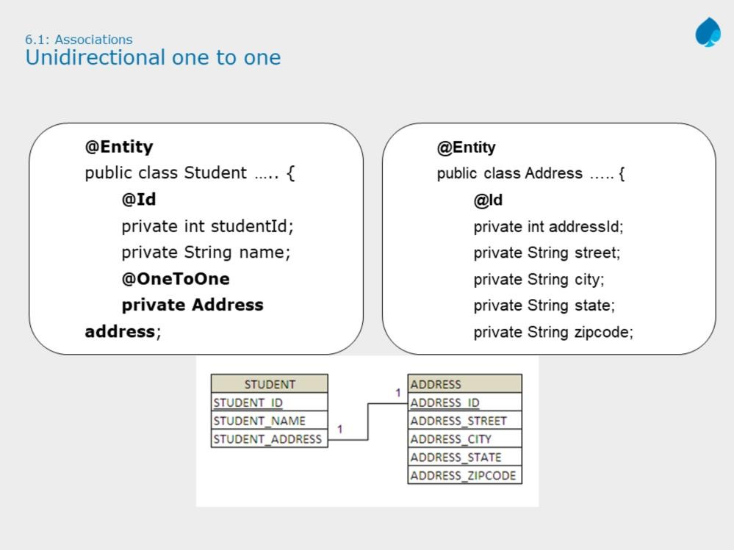
JPA with Hibernate 3.0
Instructor Notes:
Explain the need of using @JoinColumn in case of associations. Usually, while configuring JPA using annotations, most of the time JPA derives column names based on tables in association.
This may conflict if you have some other column name. For example, If we want to store address reference in student table as address_id, then the @JoinColumn annotation will help.

Slide 7
@OneToOne
Defines a single-valued association to another entity that has one-to-one multiplicity. This annotations can have following optional attributes:
cascade (Optional): The operations that must be cascaded to the target of the association. i.e. It indicates JPA operations on associated entity along with owner of association.
fetch (Optional) : Whether the association should be lazily loaded or must be eagerly fetched. i.e. When you fetch Student entity, if you want to load the associated entity (Address) immediately, then you have to mention this attribute with ‘EAGER’. Default is LAZY, means the associated entity (Address) will be loaded when required.
Note: In case of relationship, most of the times associated column name (for example, STUDENT_ADDRESS in STUDENT table) is different and creates confits, to avoid this, JPA provides @JoinColumn annotation.

Slide 8
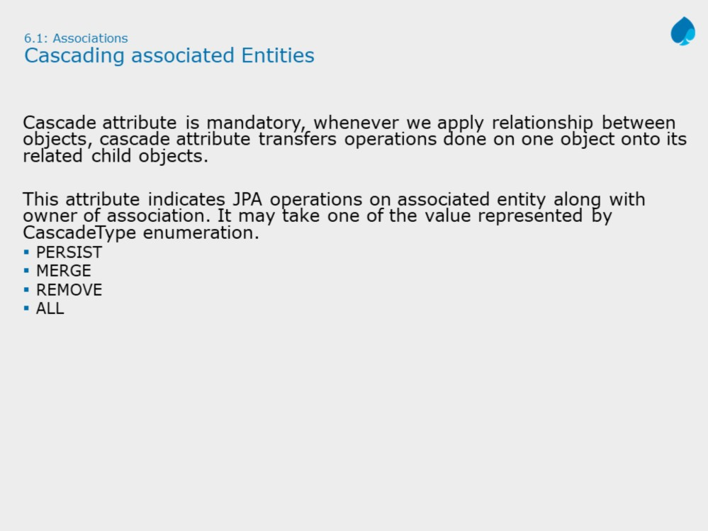

Slide 9
Cascade Types :
ALL : All cascade operations will be applied to the parent entity’s related entity. All is equivalent to specifying cascade={DETACH, MERGE, PERSIST, REFRESH, REMOVE}
DETACH : If the parent entity is detached from the persistence context, the related entity will also be detached.
MERGE : If the parent entity is merged into the persistence context, the related entity will also be merged.
PERSIST : If the parent entity is persisted into the persistence context, the related entity will also be persisted.
REFRESH :If the parent entity is refreshed in the current persistence context,
the related entity will also be refreshed.
REMOVE :If the parent entity is removed from the current persistence context, the related entity will also be removed.

Slide 10
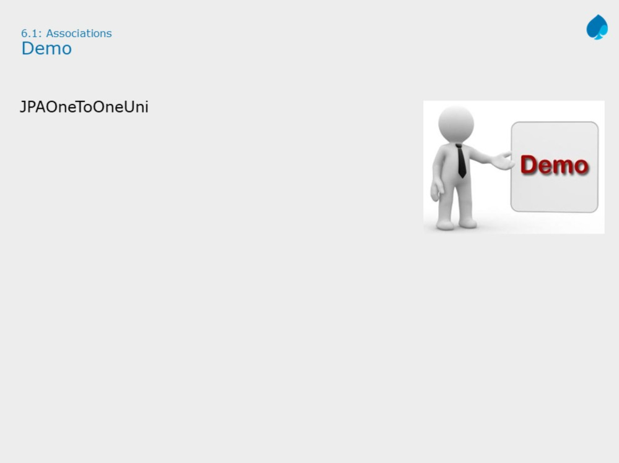

Slide 11
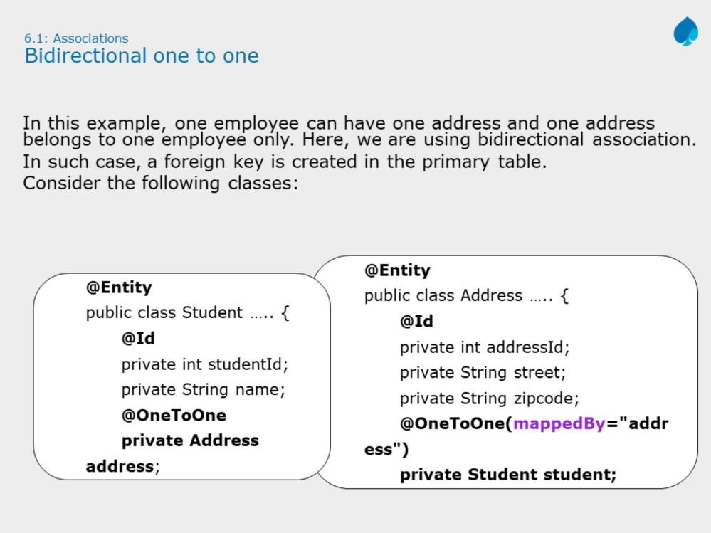

Slide 12
The direction of a relationship can be either bidirectional or unidirectional. A bidirectional relationship has both an owning side and an inverse side. A unidirectional relationship has only an owning side. The owning side of a relationship determines how the Persistence runtime makes updates to the relationship in the database.
In a bidirectional relationship, each entity has a relationship field or property that refers to the other entity. Through the relationship field or property, an entity class’s code can access its related object. If an entity has a related field, the entity is said to “know” about its related object. Such relationship field must be marked with mappedBy attribute.
The inverse side of a bidirectional relationship must refer to its owning side by using the mappedBy element of the @OneToOne, @OneToMany, or @ManyToMany annotation.

Slide 13


Slide 14
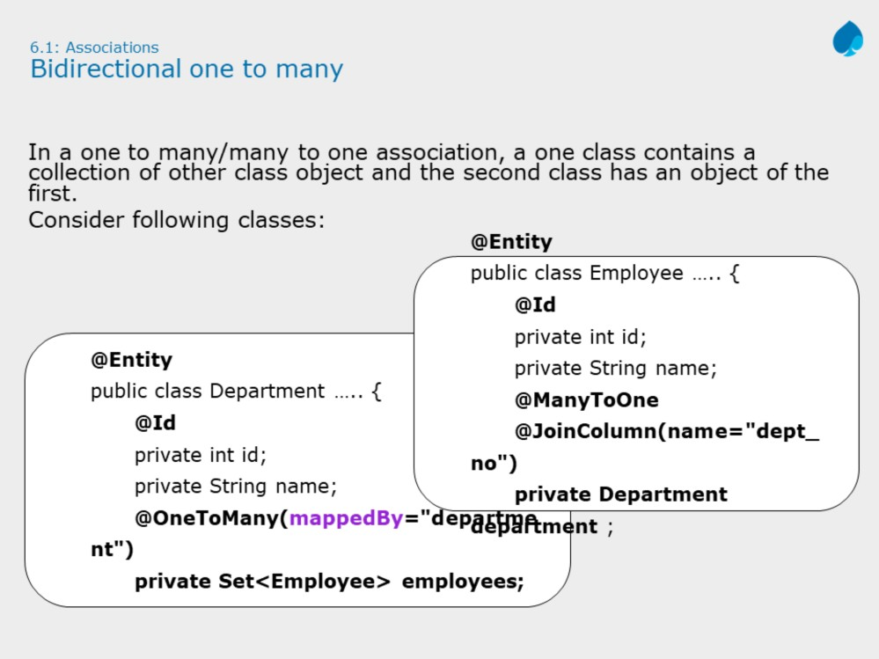

Slide 15
Slide example shows association between Department and its Employees. As one department can have many employees, we need to use @OneToMany annotation to represent this relationship. Therefore we need to use any type of collection as per given requirement. As department cannot have duplicate employees, so slide example uses Set<Employee> collection to store employees.
Note: The many side of many-to-one bidirectional relationships must not define the mappedBy element. The many side is always the owning side of the relationship. As shown in the slide, the Employee is owning side of the relationship.

Slide 16


Slide 17
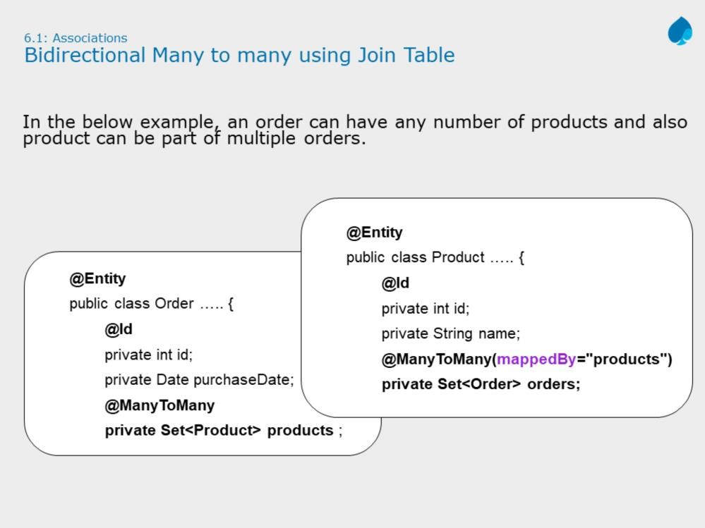
For many-to-many bidirectional relationships, either side may be the owning side. For the given example, Order acts as owning side of the relationship.

Slide 18
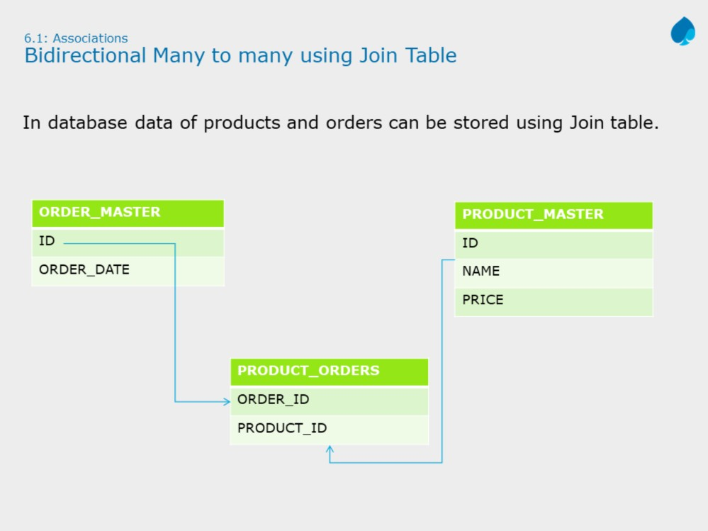

Slide 19
To store data of many to many relationship, join table can be used. As shown in slide, the orders stored in ORDER_MASTER table, products stored in PRODUCT_MASTER and there association is stored in PRODUCT_ORDERS.
To implement the above relationship with join table, JPA allows owning side of relationship to describe join table using @JoinTable annotation. For example,
@ManyToMany(cascade = CascadeType.ALL)
@JoinTable(name = "product_orders",
joinColumns = { @JoinColumn(name = "order_id") }, inverseJoinColumns = { @JoinColumn(name =
"product_id") } )
private Set<Product> products = new HashSet<>();
@JoinTable: This annotation is used to describe join table properties. It has three attributes:
name: Name of the join table
joinColumns: Join column name for owning side i.e. order table
inverseColumns: Join column name for inverse side. i.e. product table.

Slide 20
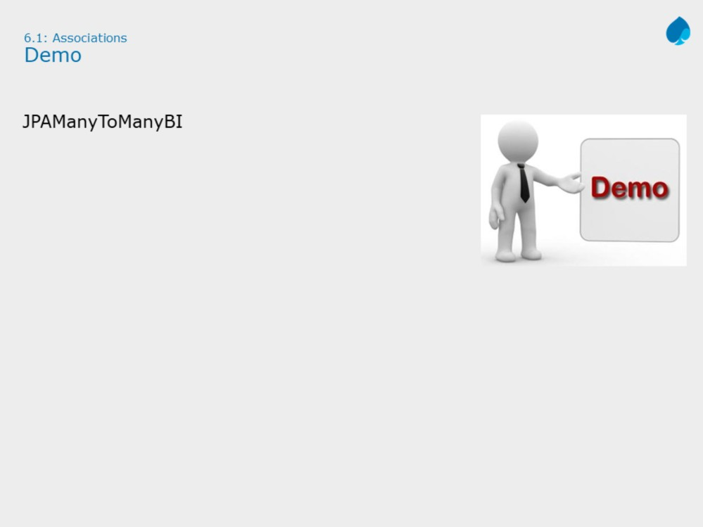

Slide 21
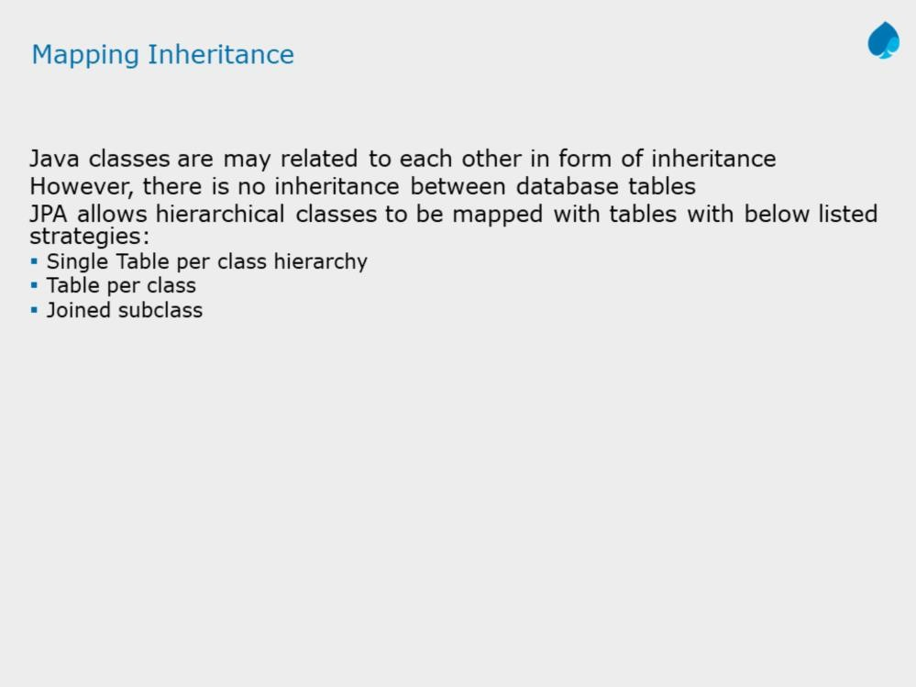

Slide 22
Three ways of handling inheritance
Single table per class hierarchy (InheritanceType.SINGLE_TABLE)
Table per concrete entity class (InheritanceType.TABLE_PER_CLASS)
“join” strategy, where fields or properties that are specific to a subclass are mapped to a different table than the fields or properties that are common to the parent class ( InheritanceType.JOINED)
Let us explore each in detail.

Slide 23
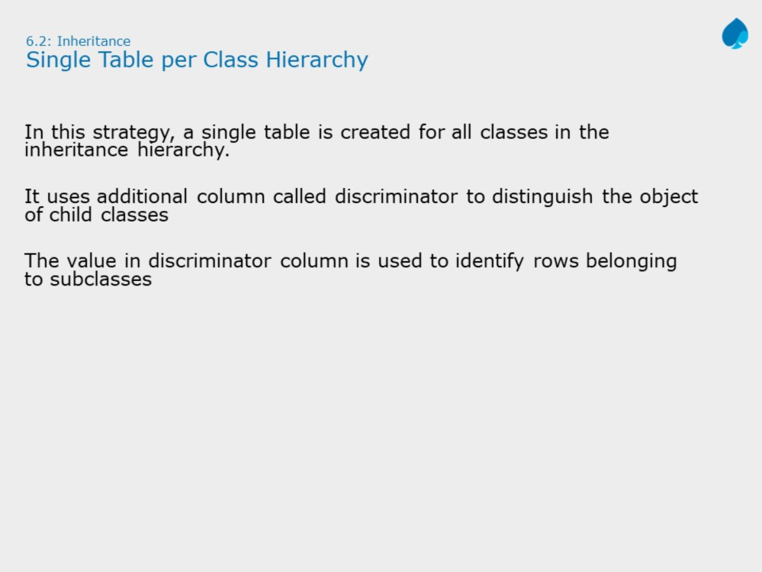

Slide 24
Single Table per Class Hierarchy:
In this strategy, only one database table is created for all subclasses. It is de- normalized table has columns for all attributes.
JPA Mapping Configuration:
Single annotation @Inheritance with InheritanceType strategy required only on superclass. Also use ‘@DiscriminatorColumn’ to define discriminator column and it data type, which later will be used to differentiate parent and child rows.
Note: Each class in hierarchy can provide optional discriminator value for its own objects rows. This is done by using @DiscriminatorValue annotation.

Slide 25
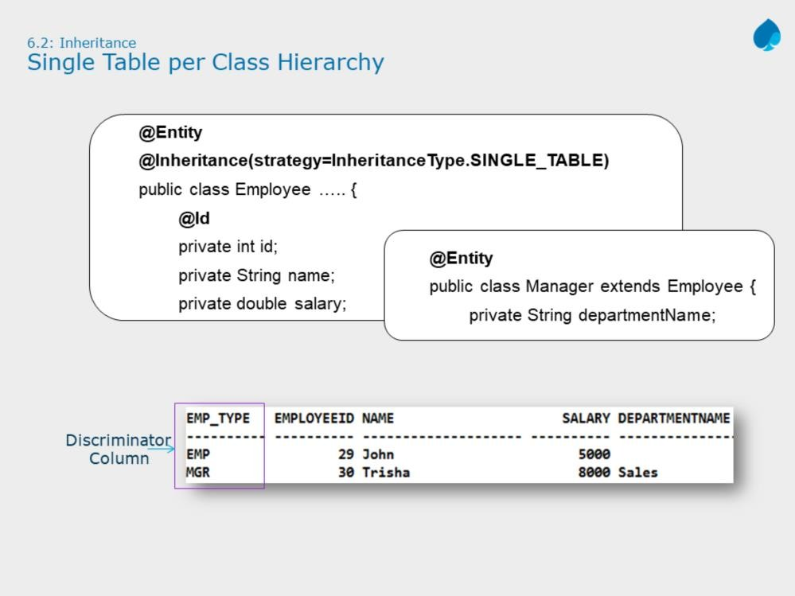

Slide 26
Advantages
It is the fastest of all inheritance models
Since it does not requires a join to retrieve a persistent instance from the database.
Persisting or Updating a persistent instance requires only a single INSERT
or UPDATE statement.
Disadvantages
1. The larger the inheritance model gets, the "wider" the mapped table gets, in that for every field in the entire inheritance hierarchy, a column must exist in the mapped table. This may have undesirable consequence on the database size, since a wide or deep inheritance hierarchy will result in tables with many mostly-empty columns.

Slide 27


Slide 28
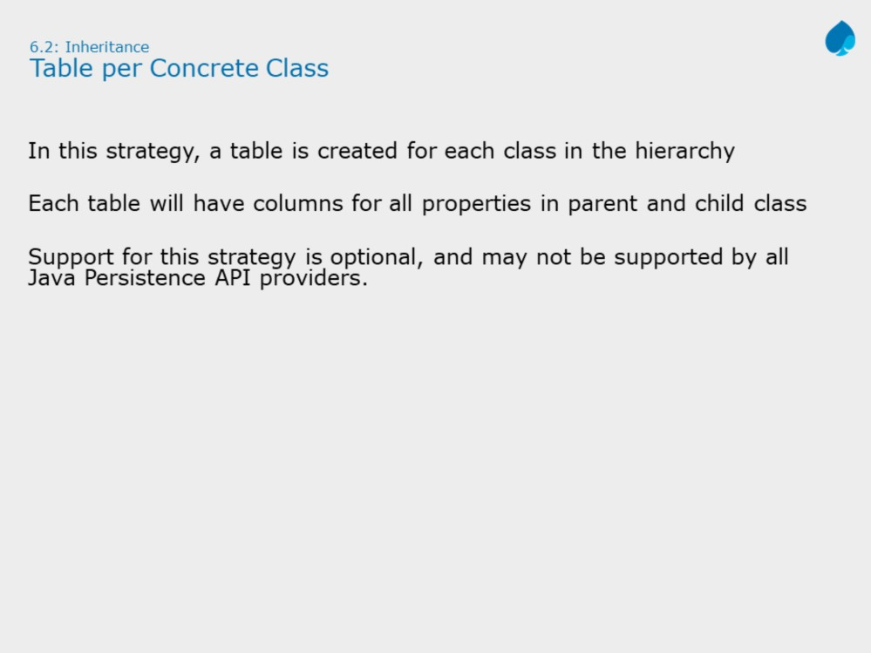
Table per concrete class:
In this inheritance strategy, one database table will be created for the superclass AND one per subclass.
Subclass tables have their object-specific columns along with shared columns from superclass table.

Slide 29
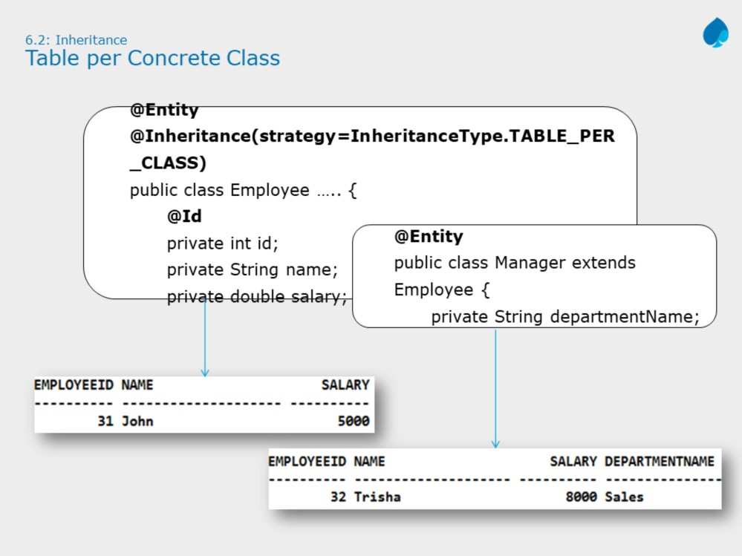

Slide 30
Advantages:
1. This is the easiest method of Inheritance mapping to implement.
Disadvantages:
Data that belongs to a parent class is scattered across a number of
subclass tables, which represents concrete classes.
This hierarchy is not recommended for most cases.
Changes to a parent class is reflected to large number of tables
A query couched in terms of parent class is likely to cause a large number of select operations

Slide 31


Slide 32
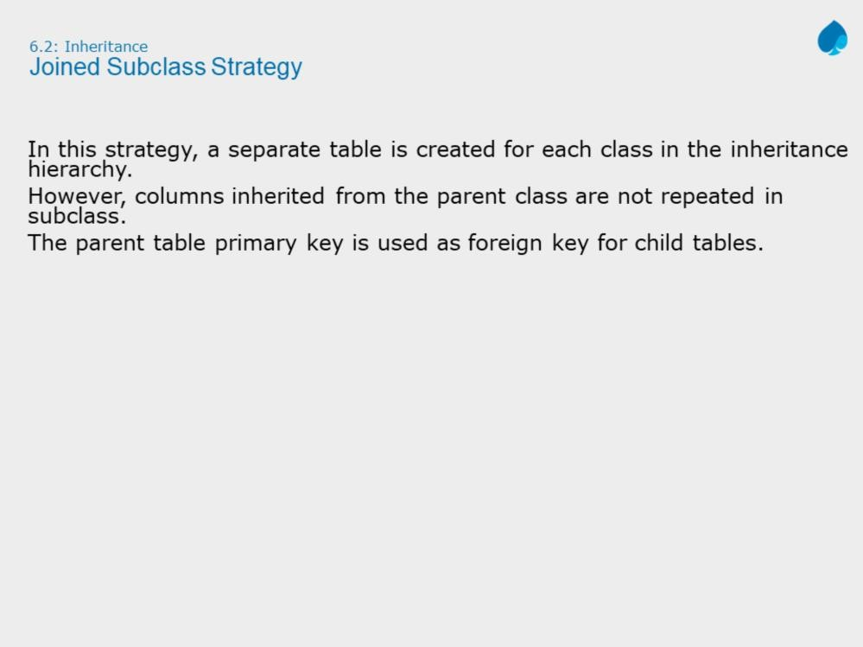
Joined Subclass Hierarchy:
In this inheritance strategy, one database table will be created for the superclass AND one per subclass.
Subclass tables have their object-specific columns along with a foreign key column referring primary key of Superclass.

Slide 33
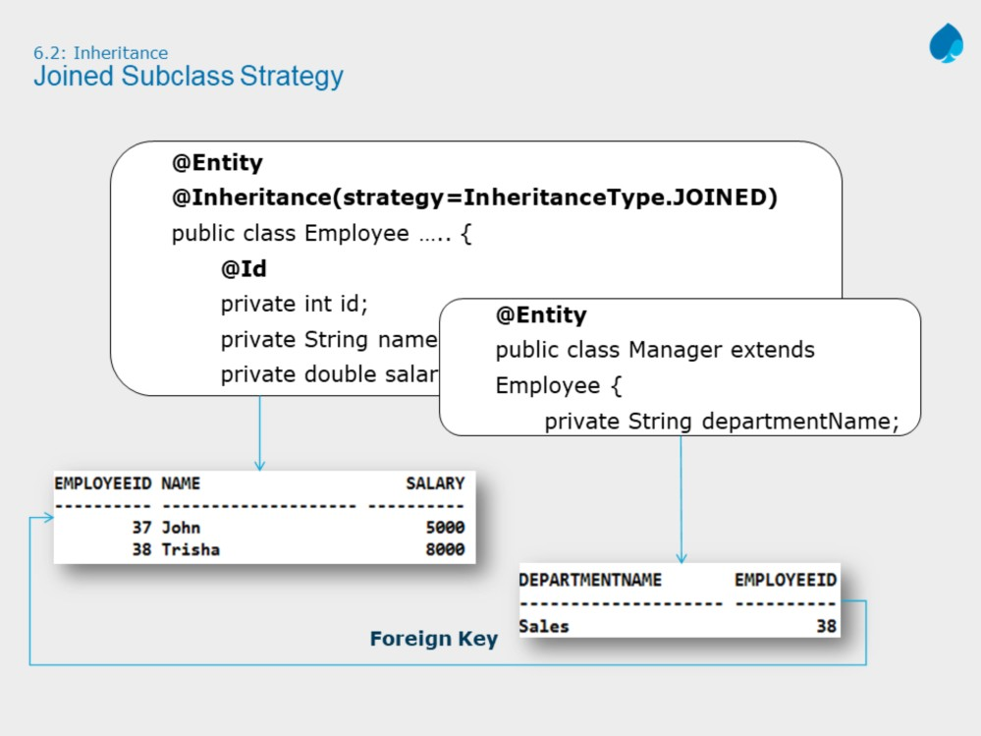
Advantages
1. Using joined subclass tables results in the most normalized database schema, meaning the schema with the least spurious or redundant data.
Disadvantages
1. Retrieving any subclass requires one or more database joins, and storing subclasses requires multiple INSERT or UPDATE statements.

Slide 34


Slide 35
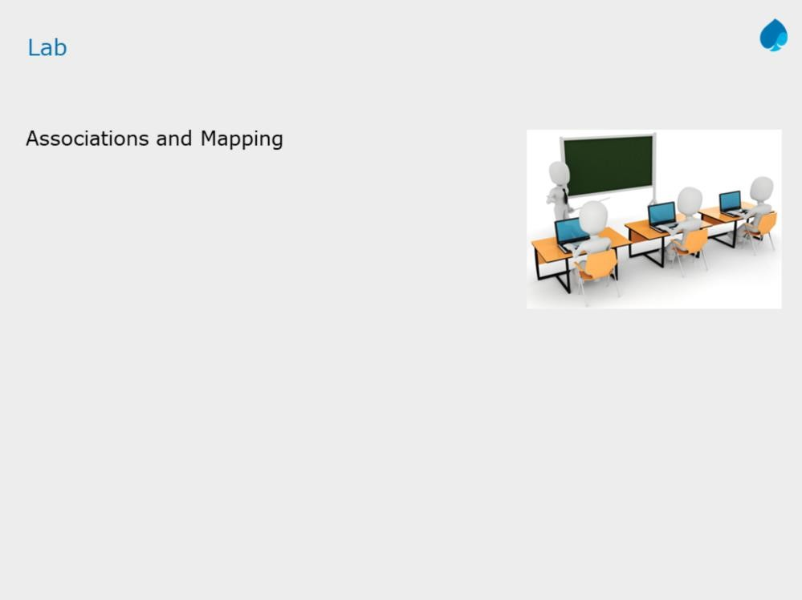

Slide 36
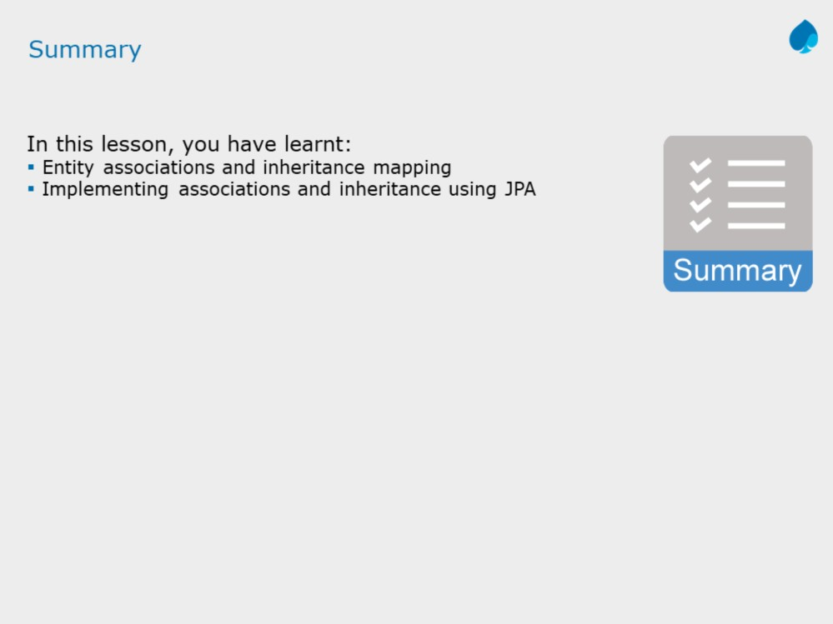

Slide 37
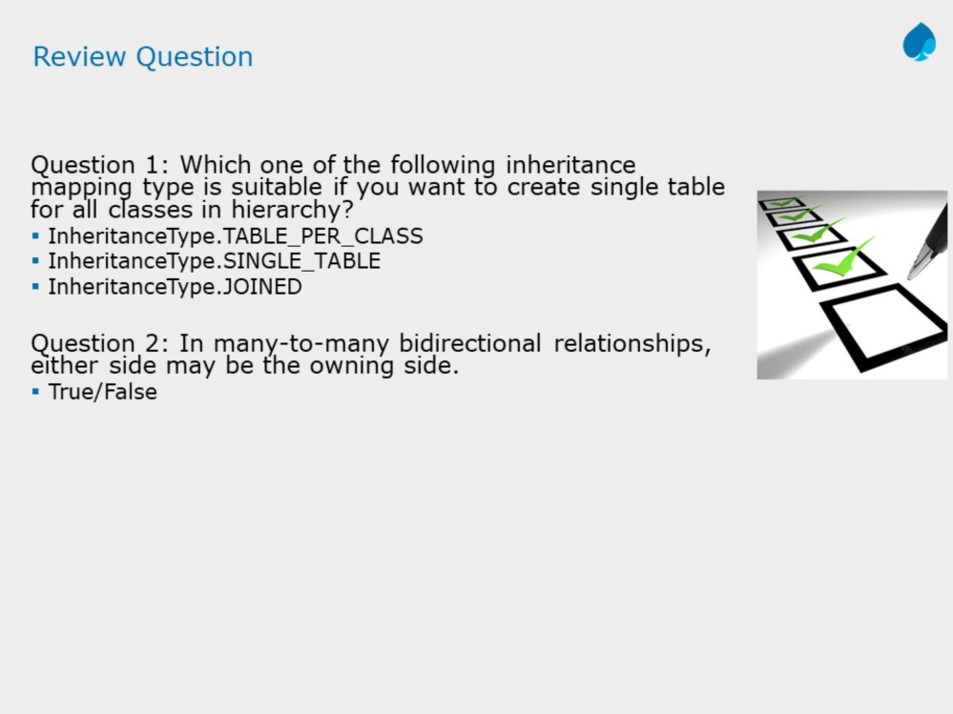
Answers:
1.InheritanceType.SINGLE_TABLE
2. True

